Slide 1
Visualization Design:
Conveying Insights
JOUR479D/779D
University of Maryland

Slide 2
Brainstorming
What are all of the ways you could possibly communicate a tiny data set of just two numbers?
A: 9
B: 6
Sketch each idea on a separate sticky note.
Don’t consider “good” or “bad” during brainstorming
Afterwards we’ll discuss.
http://blog.visual.ly/45-ways-to-communicate-two-quantities/
Notes:
http://blog.visual.ly/45-ways-to-communicate-two-quantities/
There are MANY different ways to map data to visuals. Some are better than others. Just imaging how much more complexity with more than TWO numbers!

Slide 3
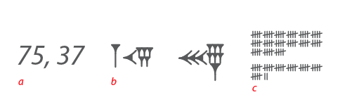
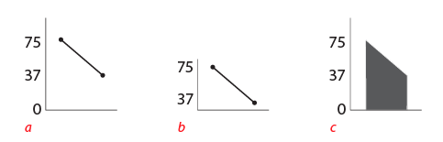
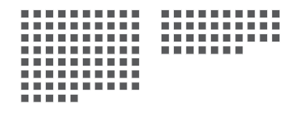
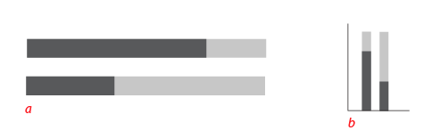
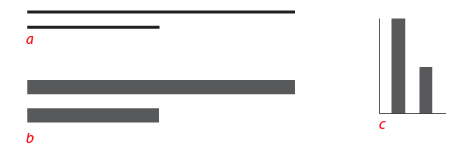
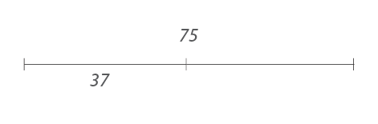
For Example

Slide 4

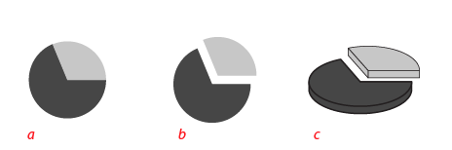

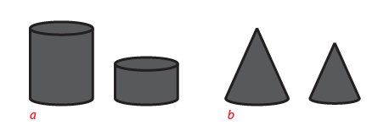
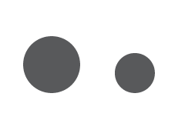

For Example

Slide 5
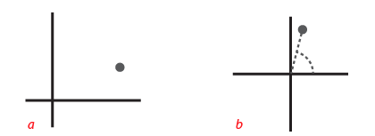
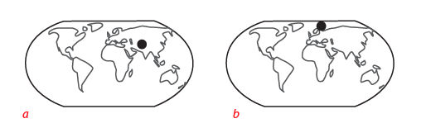

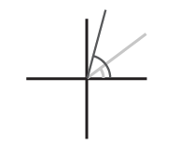
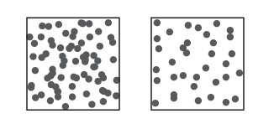
For Example
Notes:
It’s helpful to sketch ideas and explore what you can do visually with the data and data types you have available.

Slide 6
“Form Follows Function”
Visualizations are not arbitrary
Objectivity, precision, functionality constrain the forms they take
Ask: What is this for?
Discover
Present
Enjoy
Identify
Compare
Summarize
Is it helpful with any of these?
Notes:
Of course we can come up with many different ways to show data, but there are better and worse ways since these representations need to do work.
The form of your visualization should be constrained by its functions. This is the key idea about functional design.
But there is also the idea of repurposing – that forms can be repurposed for new / different functions that weren’t anticipated.

Slide 7
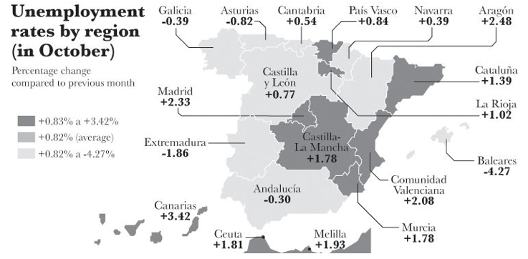
Critique
Where has unemployment grown the most?

Slide 8
Critique
Where has it dropped the most?

Slide 9
Critique
Was unemployment change bigger in Madrid or Canarias?

Slide 10
Critique
Has unemployment dropped more in Extremadura, Andalucia, or Baleares?

Slide 11
Task Design
If we anticipate questions that readers will ask, we can design visualizations so that those questions are easier to answer.
How does the design assist cognition and analytic thinking about the data?
What is this graphic for?

Slide 12
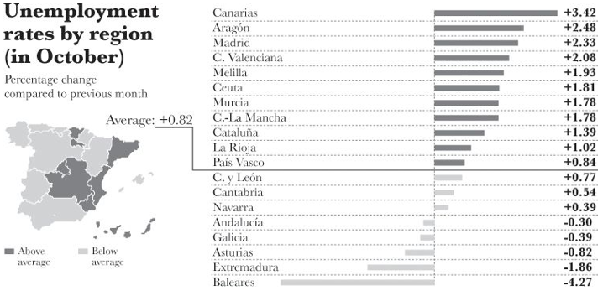
Task Design

Slide 13
Choosing the “Right” Chart
for the Task

Slide 14
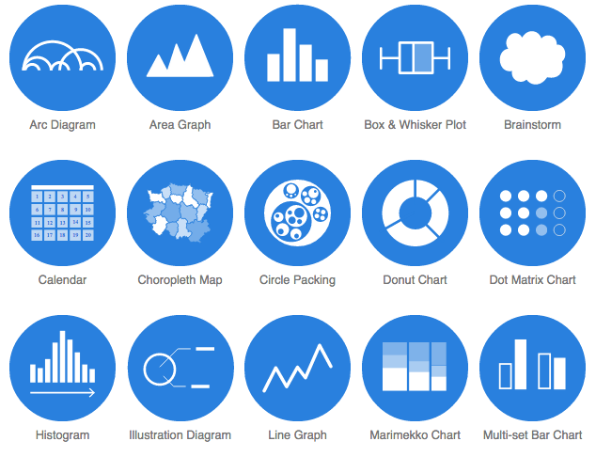
Charting: Data Viz Catalogue
Notes:
http://www.datavizcatalogue.com/
The Search by function is interesting for storytelling purposes. Helps you select a chart for a given intent.

Slide 15
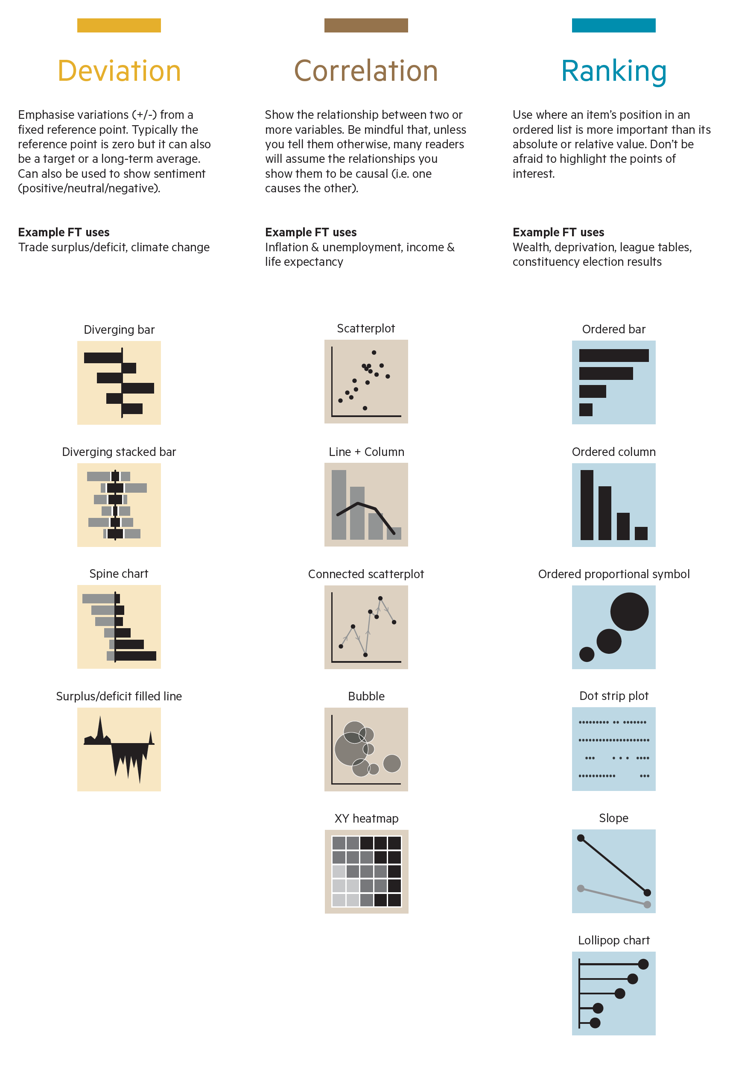
https://github.com/ft-interactive/chart-doctor/raw/master/visual-vocabulary/Visual-vocabulary.pdf
Notes:
Financial Times visual vocabulary actually makes a connection between communication goals and chart choice.

Slide 16
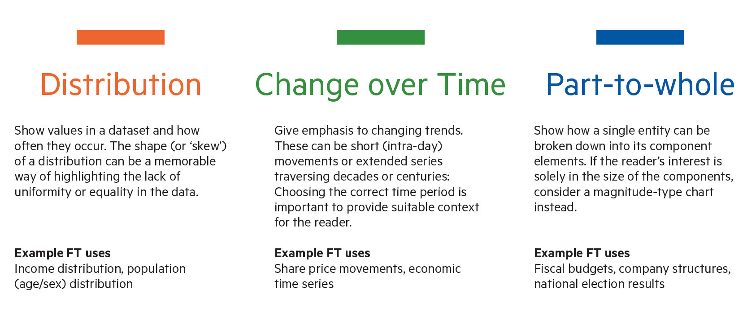
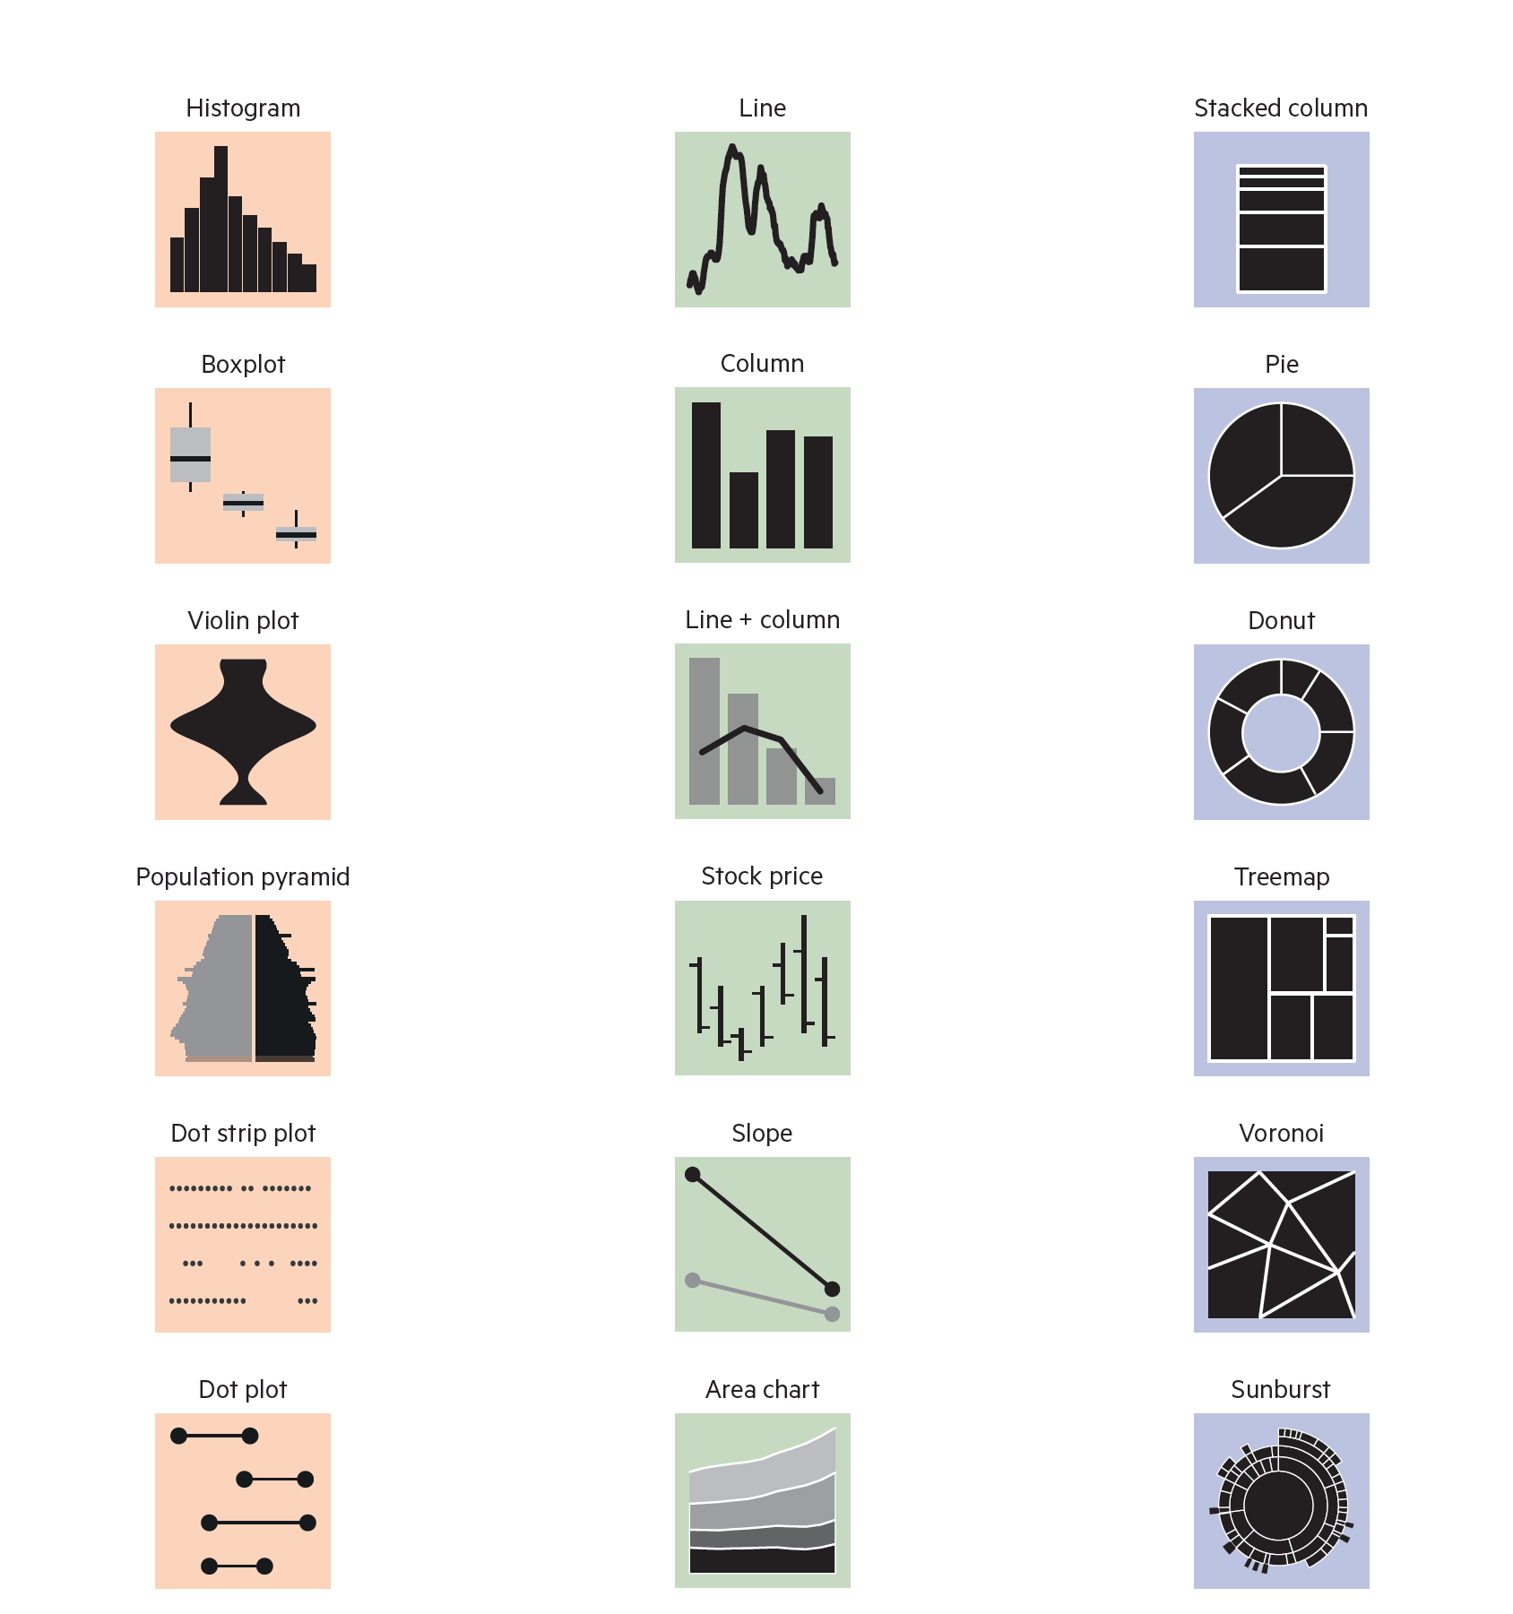
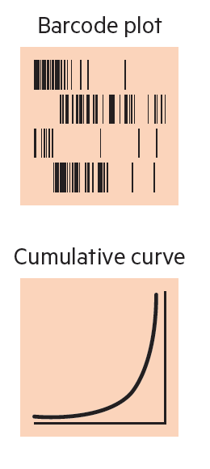
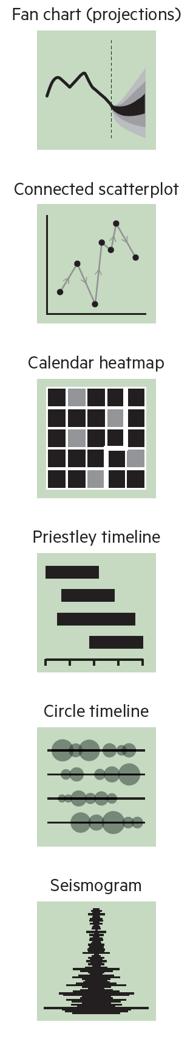
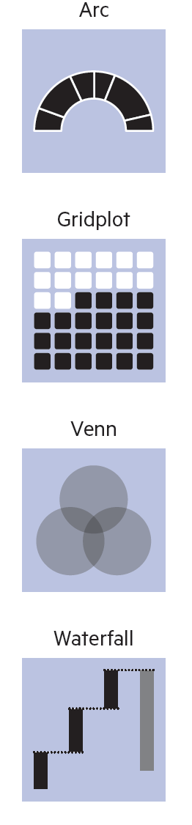

Slide 17
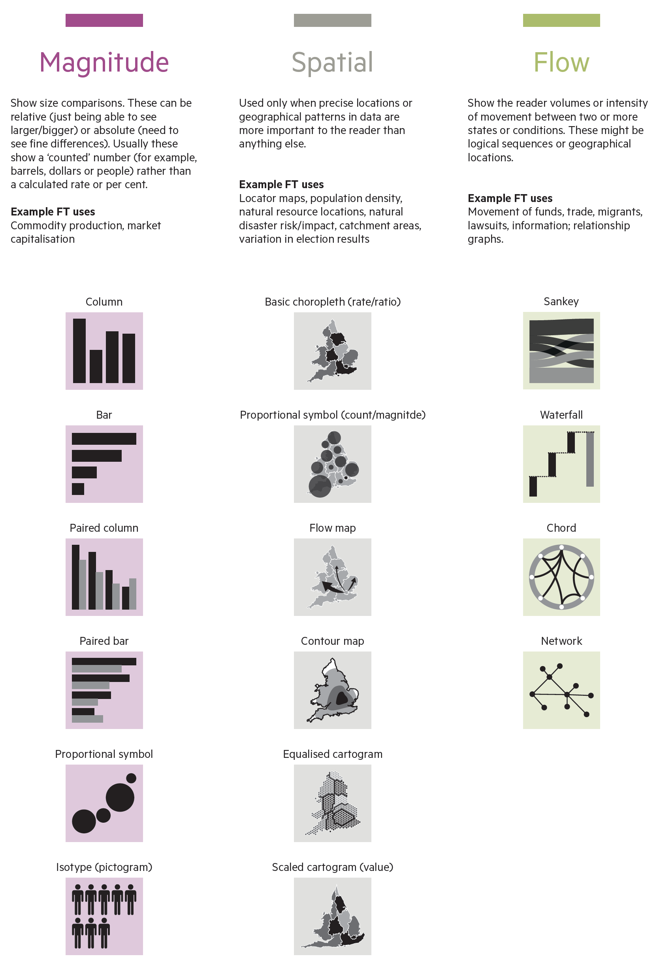
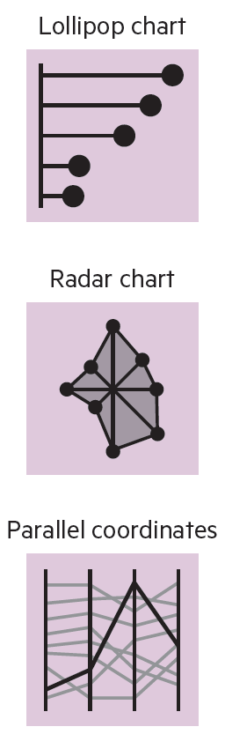

Slide 18
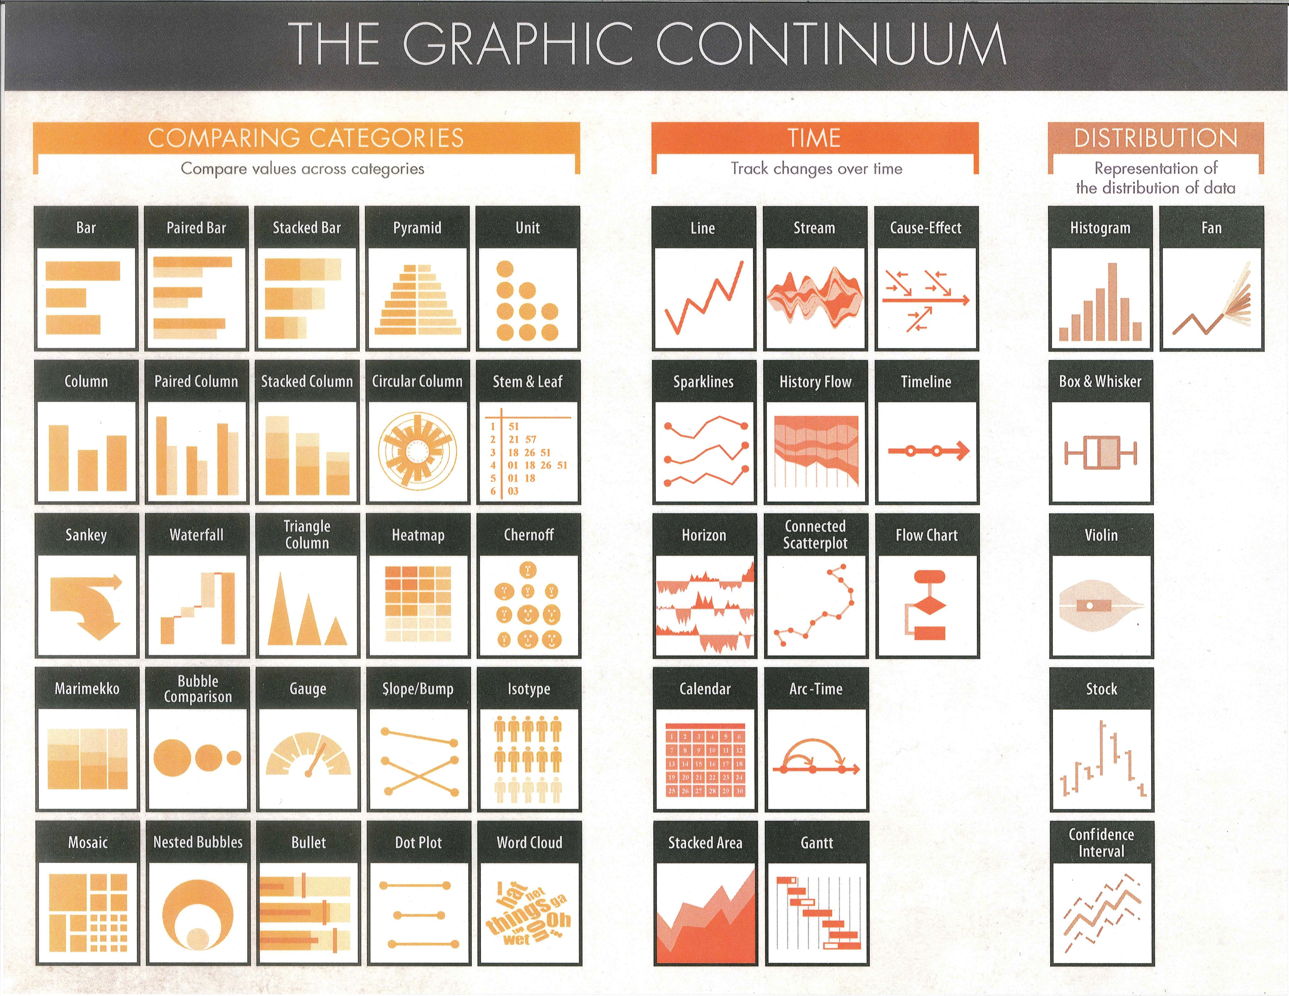
Notes:
Major decision in visualization design relates to choosing the right visual form for the data and the task that you want to support.

Slide 19
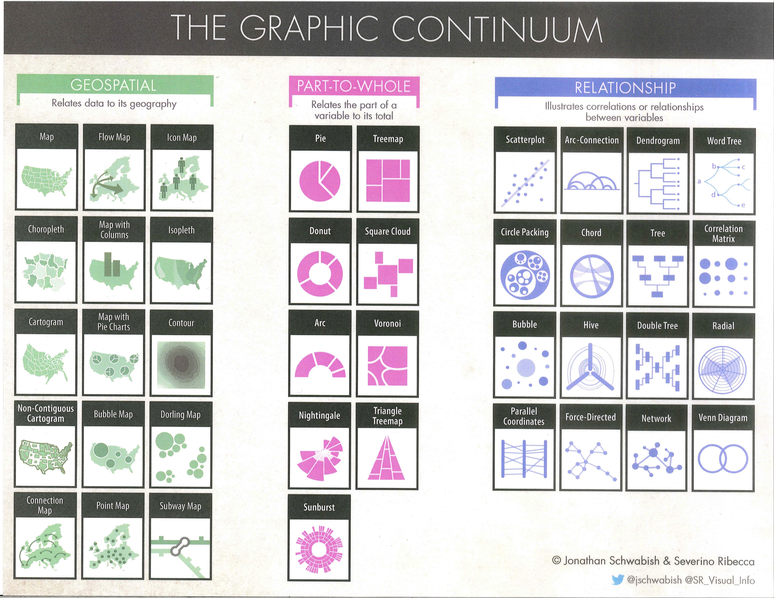

Slide 20
Design Activity
Get in pairs of 2 people
For each of the following chart captions
Discuss and take notes on which chart type you would choose to illustrate the finding and why
Share back your rationale
The majority of fatal police shootings involved suspects that were not fleeing.
The ages of white and Asian fatal police shootings are greater than of other ethnic groups.
In the 8 months through August, 2016, overall March was the worst month, and May the best in terms of number of fatal police shootings. But for Hispanics June was the worst month.

Slide 21
Chart Design

Slide 22
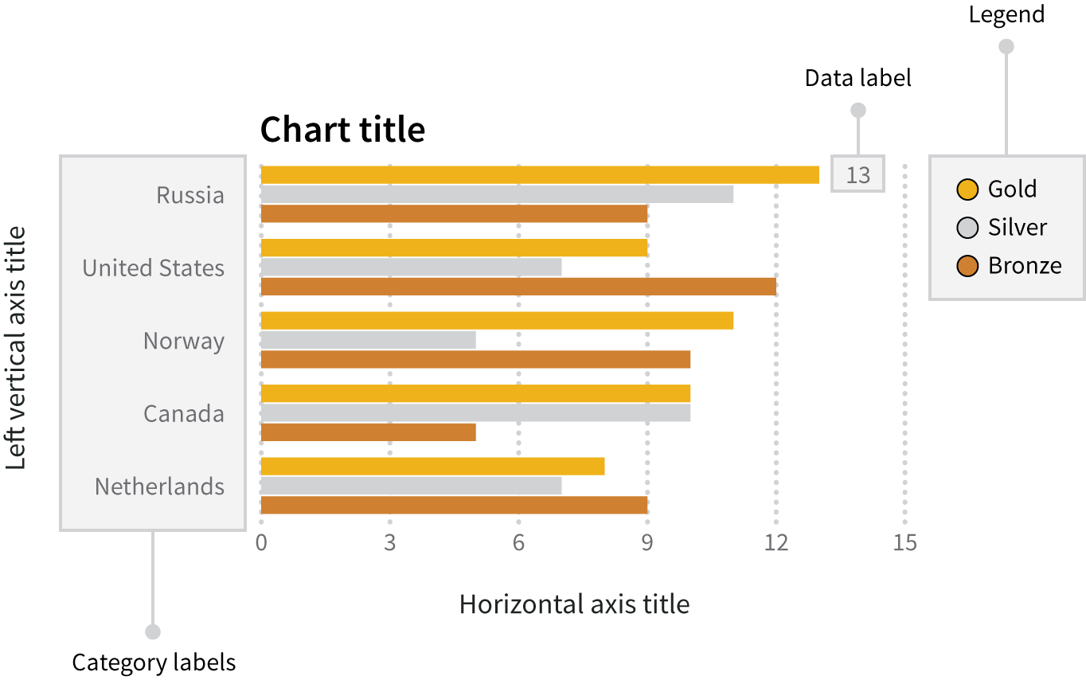
Anatomy of a Chart
Source: Data + Design. Chapter 14: Anatomy of a Graphic.
Notes:
Note: labels, guidelines, title, key, including function of each. Title is like a headline. When labeleing be sure to include units. Point out that this chart is missing a SOURCE indicator, which is essential.

Slide 23
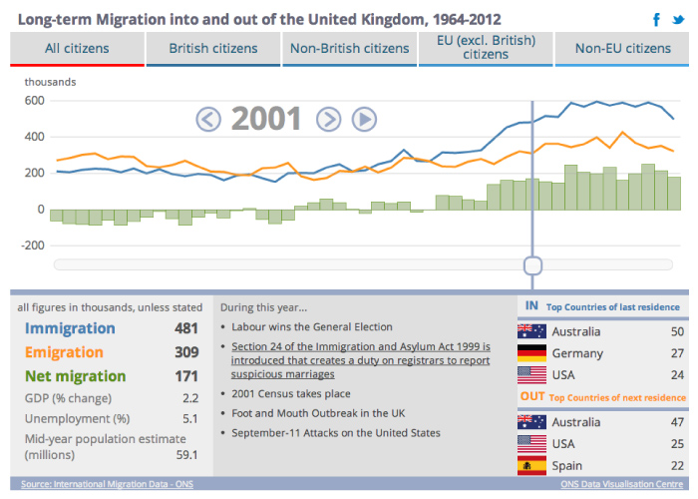
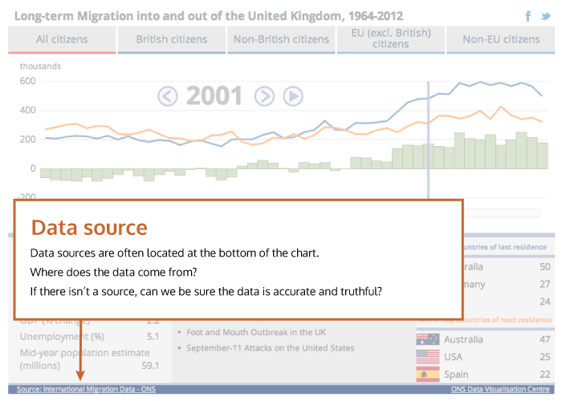
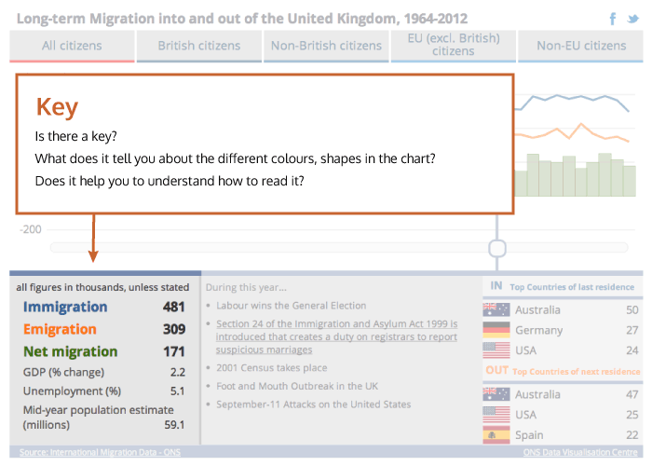
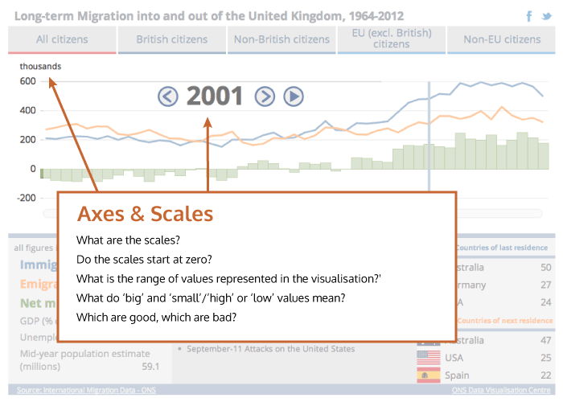
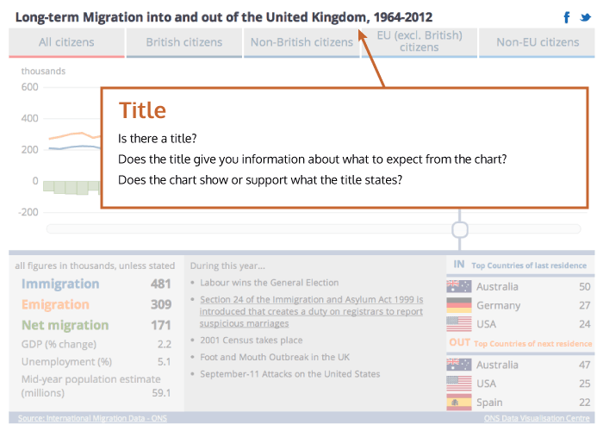
http://seeingdata.org/understanding-data-visualisations/top-5-things-to-look-for-in-a-visualisation/
Notes:
Source, also methods; title and guff or chatter.

Slide 24
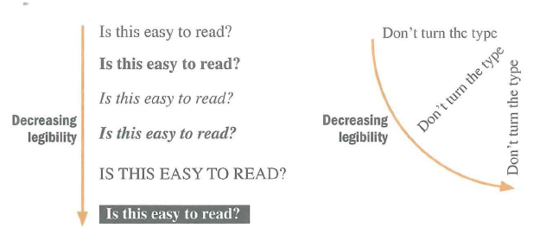
Chart Legibility

Slide 25
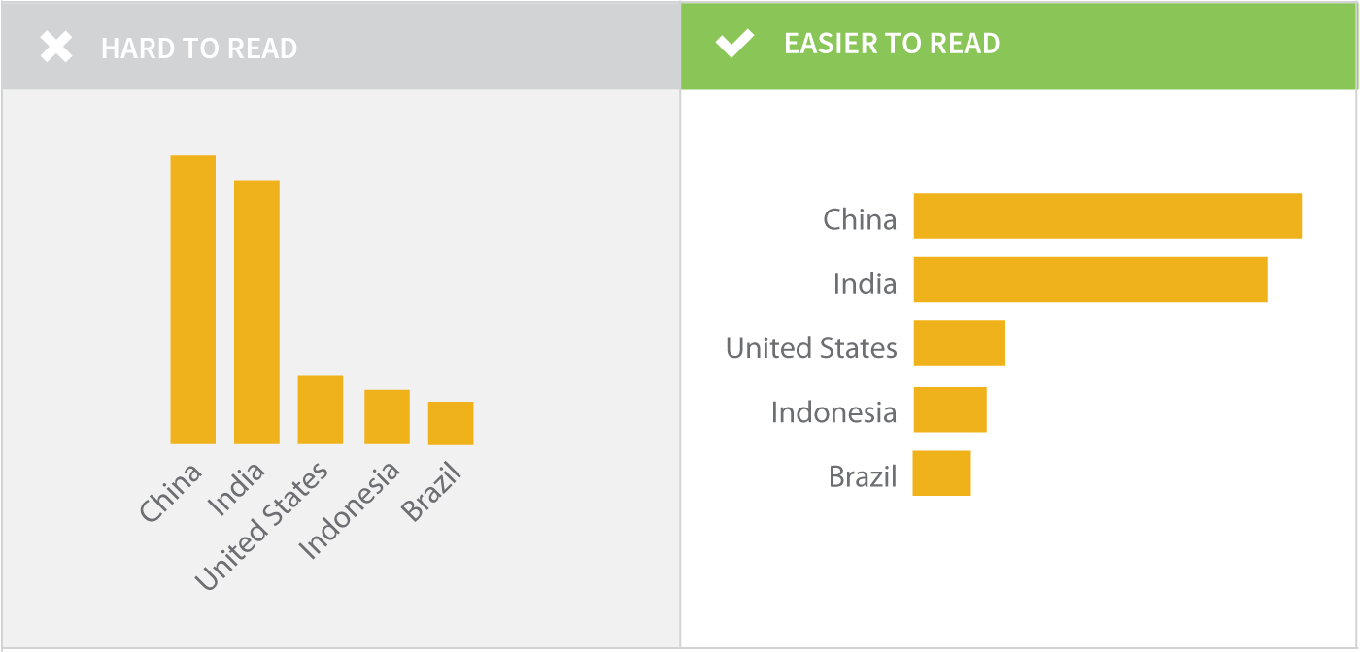
Chart Legibility
Source: Data + Design. Chapter 14: Anatomy of a Graphic.

Slide 26
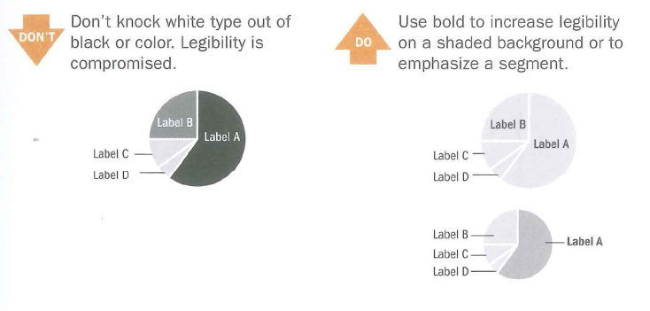
Chart Legibility

Slide 27
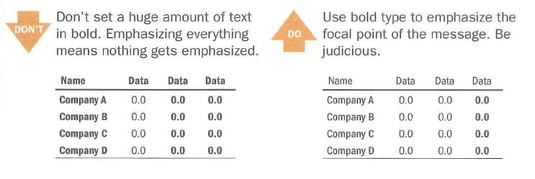
Chart Legibility

Slide 28
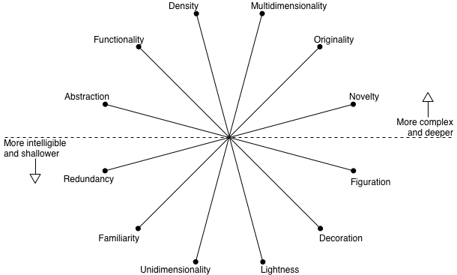
The Visualization Wheel
Notes:
Besides just efficiently encoding information, and legible presentation, there are other design dimensions we might consider and strive to balance in an information graphic. The Vis wheel can be useful for thinking through your designs.
Complexity = effort readers have to invest in deciphering a graphic
Need to always ask: what is the visualization going to be used for, and who is the audience?
Some of these dimensions if emphasized might be better for arousing curiosity, or they may be more memorable, or more utilitarian. Some may be better for more or less experienced readers.

Slide 29
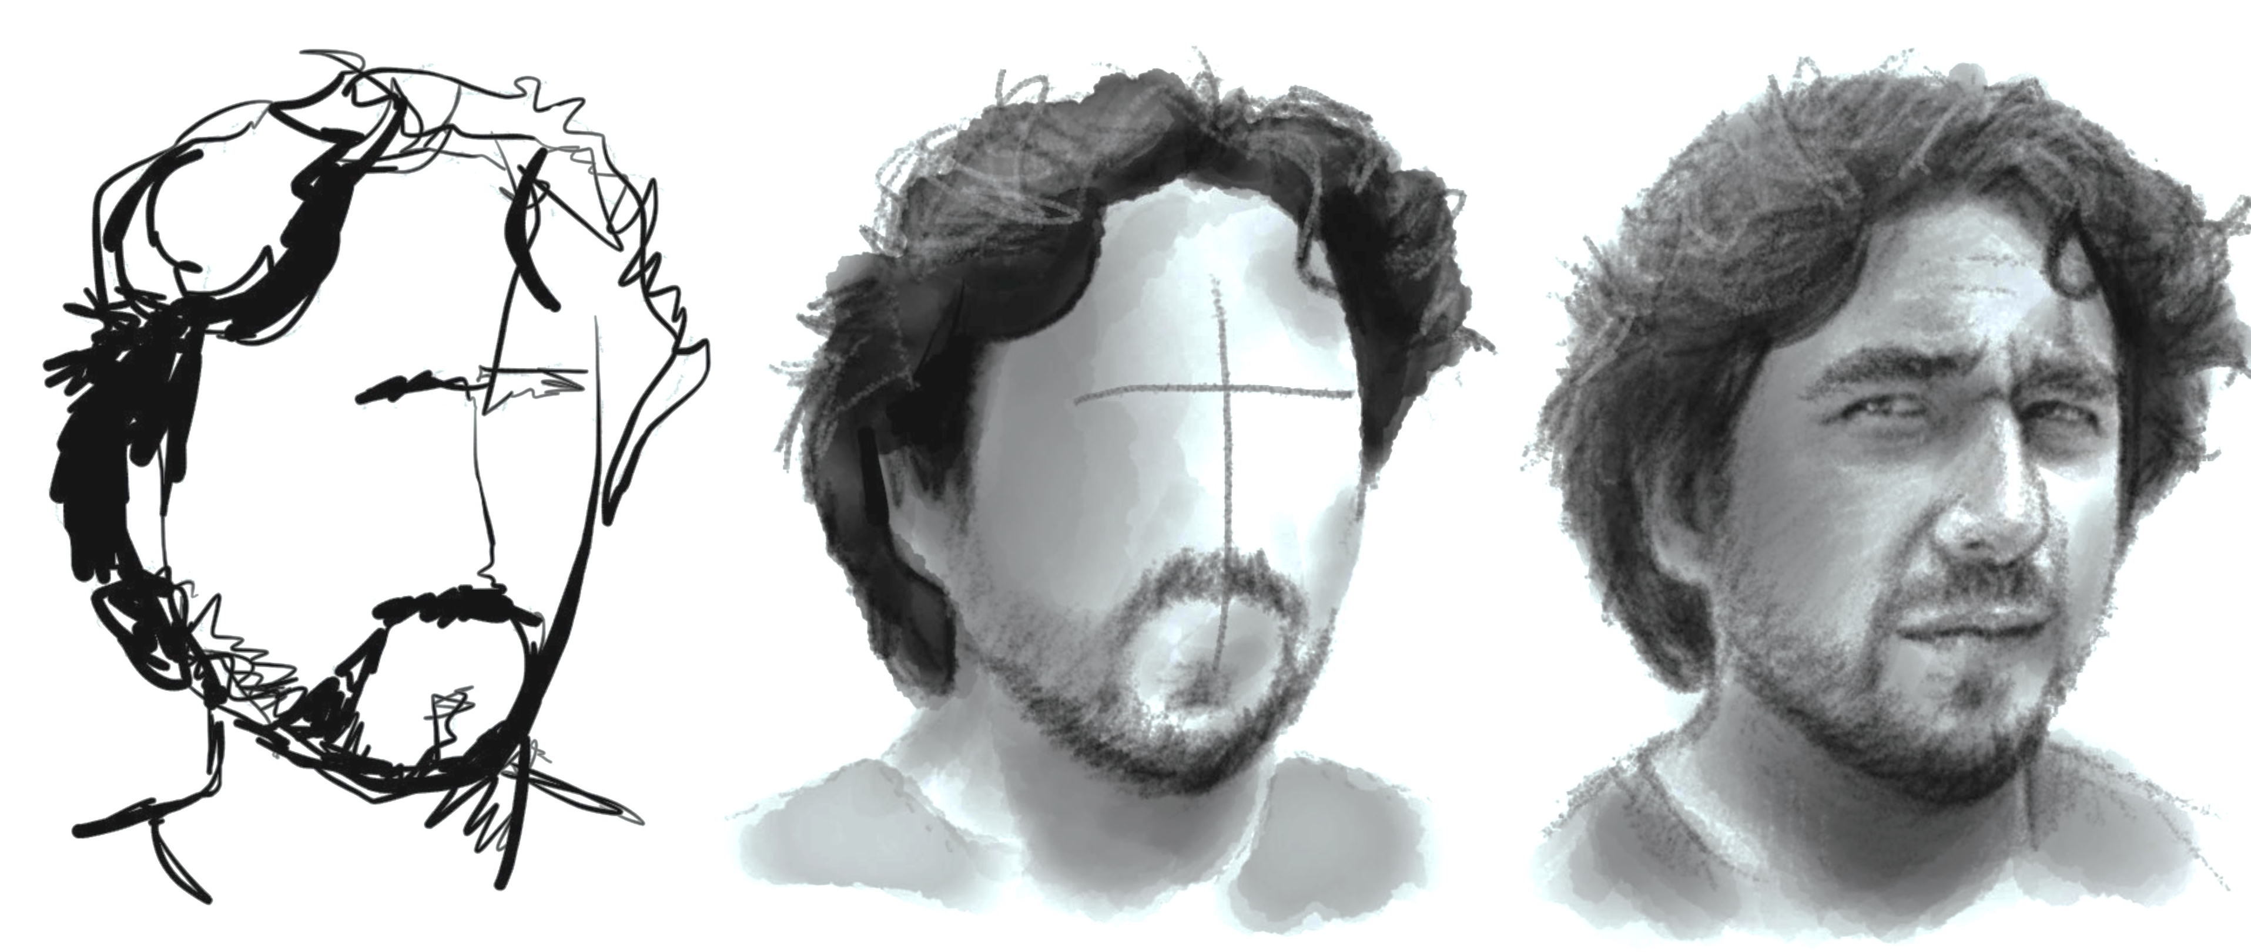
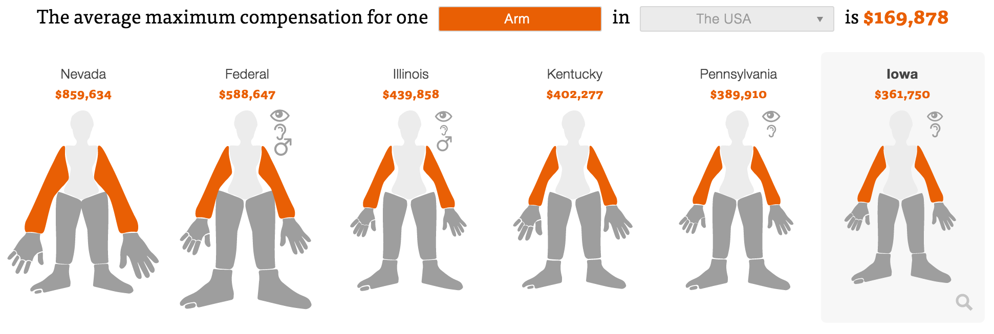
Abstraction – Figuration
Figurative
Representation mimics real world
Abstract
Conceptual, reduced realism, doesn’t map directly to world
https://projects.propublica.org/graphics/workers-compensation-benefits-by-limb#

Slide 30
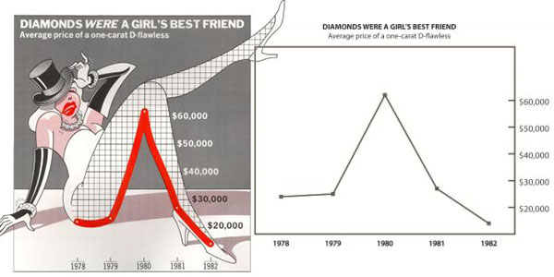
Functionality – Decoration
Decoration
Non-functional elements that do not aid interpretation
“Chartjunk” – “If the numbers are boring, then you’ve got the wrong numbers” – E. Tufte.

Slide 31
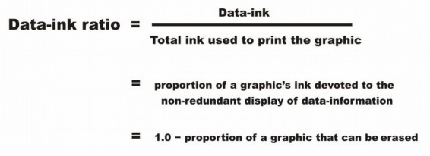
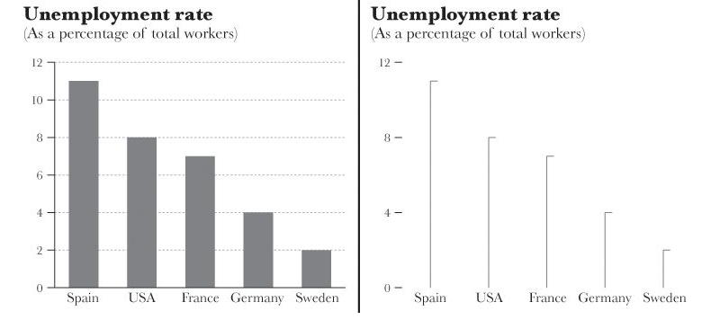
Density – Lightness (Data-Ink Ratio)

Slide 32
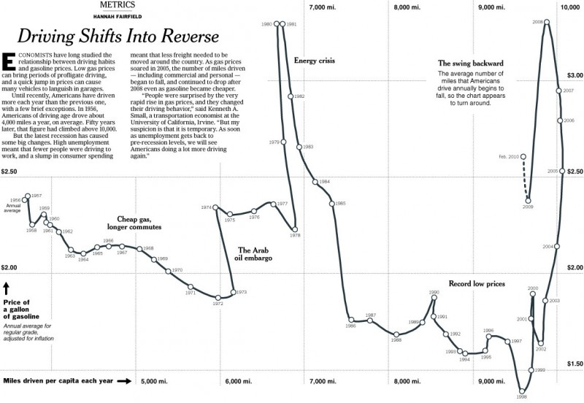
Originality – Familiarity
Notes:
But the fire line charts published in news papers in the mid 1800s also had to be very clearly explained, with extensive captions about how to decode info.

Slide 33
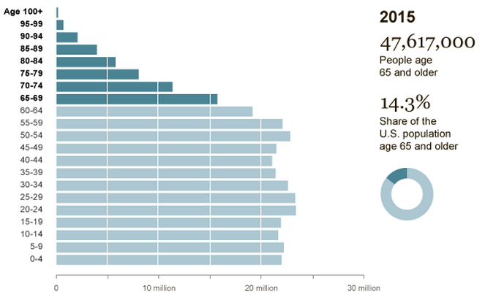
Novelty – Redundancy
Notes:
Novelty: explain many different things once
Redundancy: explain same things several times
Example: on right there is redundancy, on left there is a novel view showing more detail on the distribution

Slide 34
User-Centered Design
What is this visualization for?
Explaining, exploring, contextualizing
Who is the audience?
How much knowledge of the topic do they have?
Try to clarify, not simplify
Do I want to …
…arouse curiosity
…make this memorable
…have people spend more time
…facilitate a decision efficiently
Notes:
Need to always ask: what is the visualization going to be used for, and who is the audience?
Some of these dimensions if emphasized might be better for arousing curiosity, or they may be more memorable, or more utilitarian. Some may be better for more or less experienced readers.
For instance some studies of so-called chartjunk show that those graphs are more memorable, and that the high data-ink ratio version of charts are not preferred by users.

Slide 35
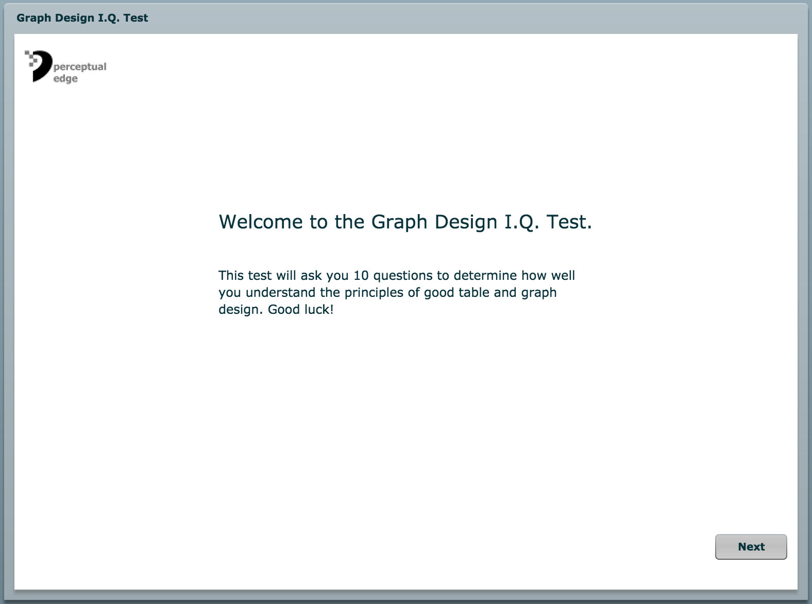
http://www.perceptualedge.com/files/GraphDesignIQ.html
Notes:
A group quiz for discussion.

Slide 36
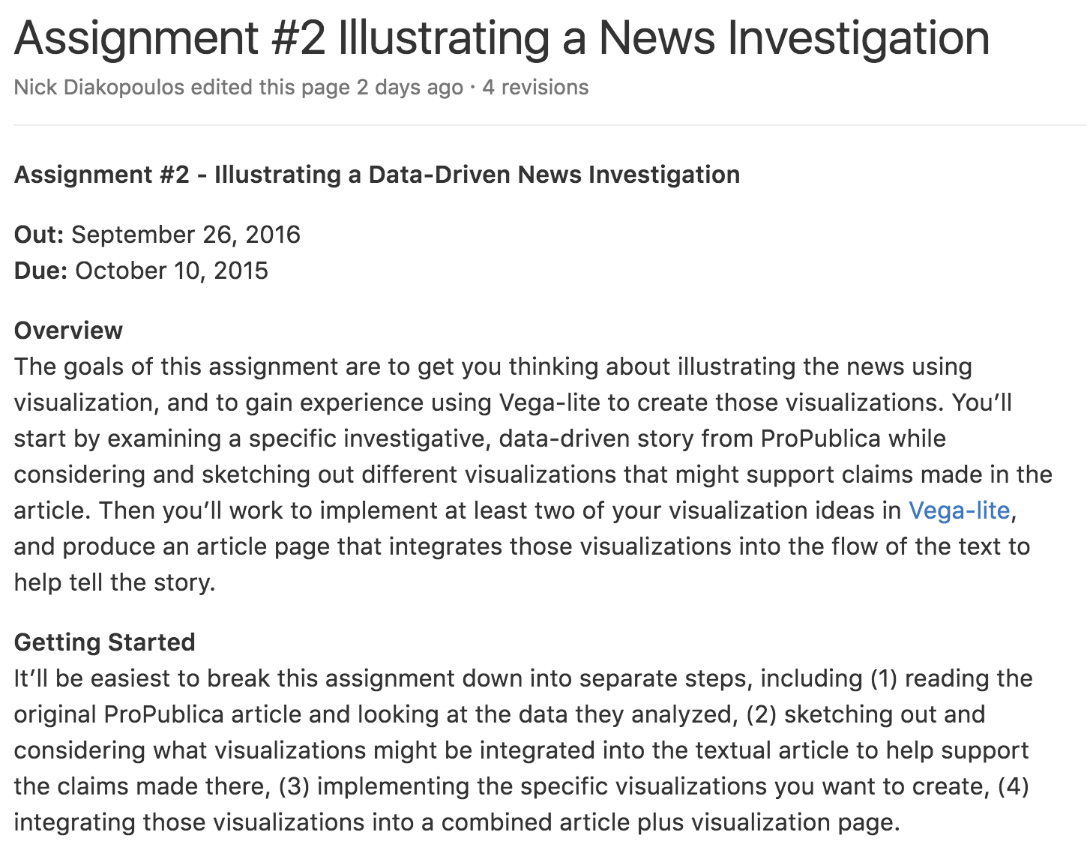

Slide 37
Questions?

